Slide 1
A Compact FEL-Driven
Inverse Compton Scattering
High-Energy Gamma Ray Source
M. Placidi, S. Di Mitri, C. Pellegrini and G. Penn
NIM-A 855 (2017) 55–60
http://doi.org/10.1016/j.nima.2017.02.072

Slide 2
OUTLINE
TRENDS IN H. E. X-RAY BEAM APPLICATIONS
MOTIVATION
THE FEL-ICS SYSTEM
COMPONENTS
PERFORMANCE
OUTLOOK

Slide 3
TRENDS IN HIGH ENERGY X-RAY BEAMS APPLICATIONS
CALIBRATION OF EXISTING X-RAY INSTRUMENTATION (LLNL)
HOMELAND SECURITY
  INSPECTION OF ILLEGAL CARGOS
  DETECTION OF CONCEALED NUCLEAR MATERIALS
  GAUGING RADIOLOGICAL / NUCLEAR THREATS
INDUSTRIAL QUALITY CONTROLS
CULTURAL HERITAGE PRESERVATION AND ARCHAELOGICAL STUDIES

Slide 4
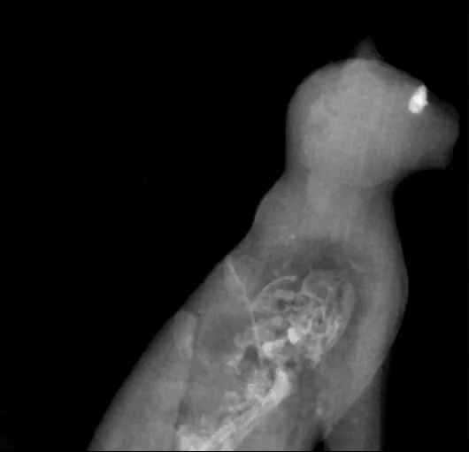
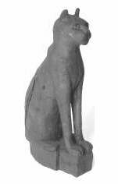
INITIAL MOTIVATION
Courtesy: Museo Civico Archeologico, Bologna
CULTURAL HERITAGE PRESERVATION
ARCHAEOLOGICAL RECOVERY and RESTORATION
A real cat skeleton inside…

Slide 5
CULTURAL HERITAGE ASSETS
MANY EXHIBIT DEMANDING CHARACTERISTICS
FRAGILE
HIGH DENSITY
DIFFICULT TRANSPORTATION
IMMOVABLE

Slide 6
UV FLUORESCENCE IMAGING
Courtesy: PHOTOEVOLUTION and F. CASALI
ANCIENT MANUSCRIPTS

Slide 7
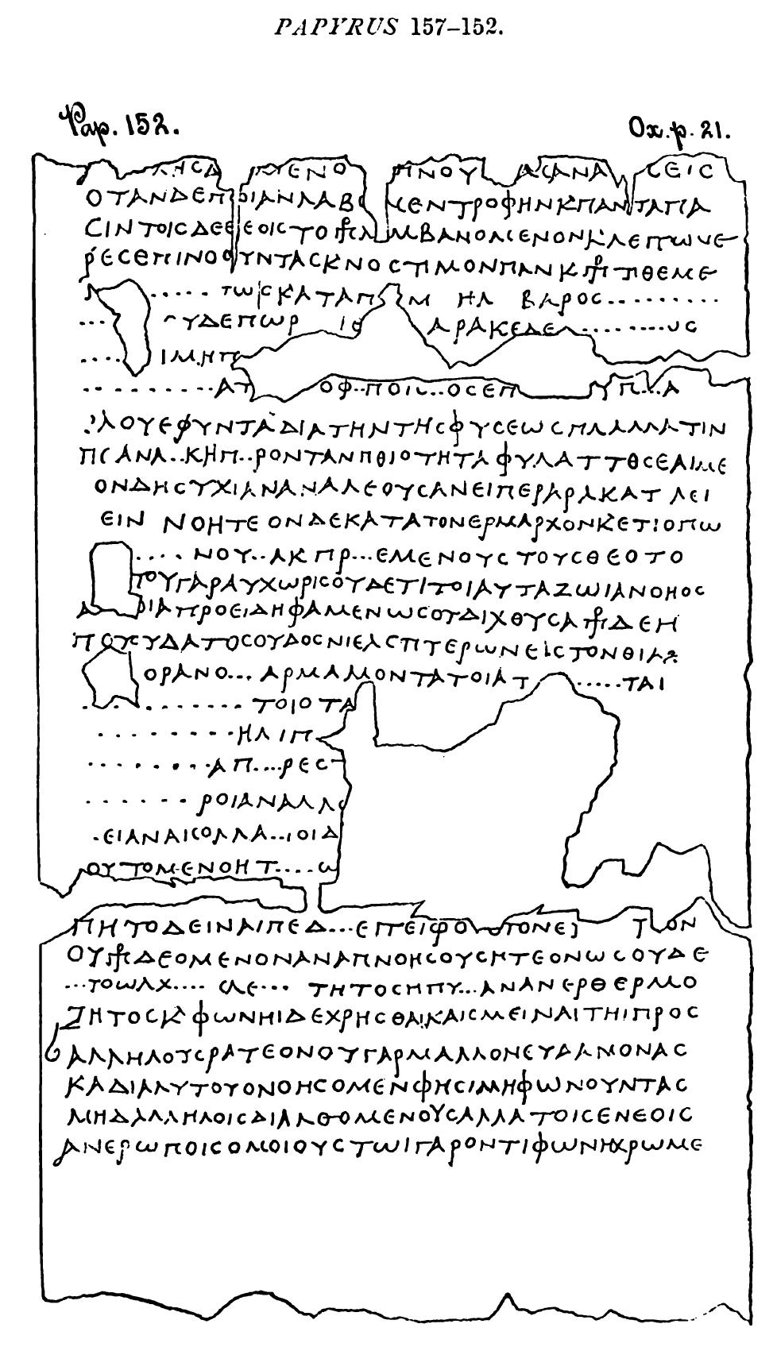
READING ANCIENT MANUSCRIPTS
WITHOUT OPENING THEM
THE HERCULANEUM ROLLS
More than1800 papyri carbonized during the
AD 79 Mount Vesuvio eruption
Initial invasive approaches: rolls destroyed, ink disappeared
Non-invasive: X-Ray Phase Contrast Tomography (XPCT)
(Prof. V. Mocella / CNR-IMM /CEA Grenoble)

Slide 8
SOIL BLOCKS
A. Re et al. Heritage Science (2015) 3:4
SOIL BLOCK
Necropolis of Villa Alfonsina, Chieti
Probably VI-IV century BC

Slide 9
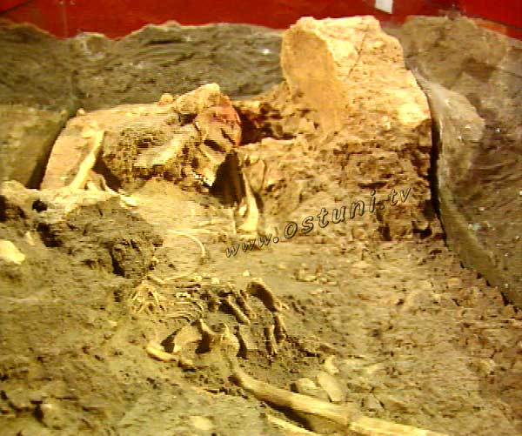
OSTUNI “MOTHER”
Discovered: 1991 (Prof. D. Coppola / Tor Vergata University)
Visible: Parco S. Maria di Agnano / Salento
Dated ~28.000 years / pleistocenic era (Leipzig University)
Studies on transportable fragments performed at Sincrotrone Trieste / Linea Syrmep
Credit: Lucia Mancini, Giuliana Tromba

Slide 10
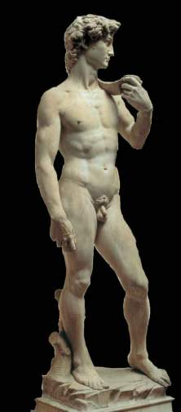
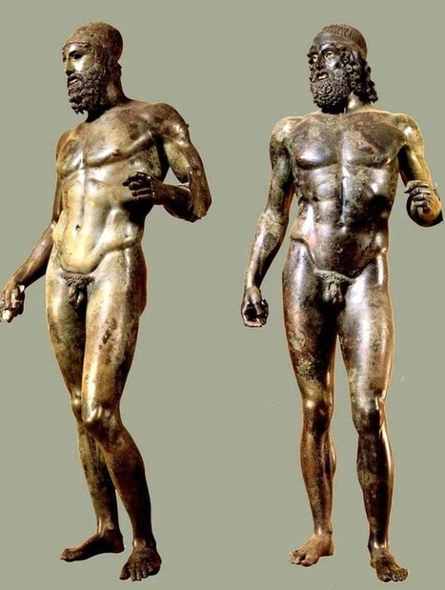
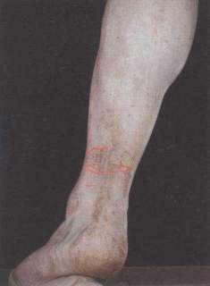
IMMOVABLE
THE RIACE BRONZES
ANKLE CRACKS IN
MICHELANGELO’S DAVID

Slide 11
NOVEL COMPACT PHOTON SOURCE
SIMULTANEOUS SOURCE OF UV AND MULTI-MeV PHOTONS
TUNABLE AND MONOCHROMATIC
BETTER ENERGY-EFFICIENCY THAN X-RAY TUBES
REDUCED RADIATION DOSE
IMPROVED IMAGING RESOLUTION
MORE COMPACT THAN SR-BASED SOURCES

Slide 12
INVERSE COMPTON SCATTERING
α
φ
λ_{out}
γ_{e}
θ = ±1/γ
e-
λ_{in}
NOVEL:
CONVENTIONAL:
Laser
Undulator
Scattered Photon Energy scales as
the square of the electron Energy
Outgoing Photon Energy scales as
the 4th power of the electron Energy

Slide 13
ICS FEL-ICS
THE FEL-ICS AS AN ALTERNATIVE TO THE STANDARD ICS SCHEME
α
α
φ
λ_{out}
φ
λ_{out}
γ_{e}
e-
γ_{e}
e-
λ_{in}
λ_{in}
Laser
Undulator
γ_{eu}
Scattered Photon Energy scales as
the square of the electron Energy
Scattered Photon Energy scales as
the 4th power of the electron Energy

Slide 14
ICS FEL-ICS
SCATTERED RADIATION ENERGY
RADIATED X-Rays
INCOMING e-
RADIATED X-Rays
~3 MeV
300 MeV
~17 MeV
~8.5 MeV
500 MeV
~121 MeV
THE FEL-ICS PROVIDES LARGER RADIATED ENERGY PER INCOMING e- ENERGY

Slide 15
THE FEL-ICS SCHEME
THE e- BEAM INTERACTS WITH ITS OWN RADIATION GENERATED IN A FEL
SYNERGY OF THREE MODERN CUTTING-EDGE TECHNOLOGIES
Reduced value of Thompson cross section:
FEL radiation available
to experimentation in the UV Energy range.
SIMULTANEOUS SOURCE OF
UV and GAMMA-RAY RADIATION
UV radiation
High-energy gamma rays
IP
e-
All X-Band Linac
φ
e-
e- dump
Matching
optics
Trains of electron bunches from an All X-band Linac
FEL
Return Arc
Compressor
travel into a Compressor Arc to a FEL radiating magnetic structure
emitting UV radiation before being dumped.
FOOTPRINT : ~ 4 x 22 m²
ICS of UV photons on trailing e- bunches
produces High Energy Gamma Rays

Slide 16
THE LINAC
L_{L}
  High gradient X-Band Technology for Photoinjector AND Accelerating Structure
  ALL X-BAND TECHNOLOGY
Multi-bunch Operation
f_{RF} : (11.4-12.0) GHz
V_{acc} = 35 MV/m
L_{L}~10m
SLAC STUDIES
(C. Limborg, C. Adolphsen)

Slide 17
e- BEAM TIME STRUCTURE
e-
UNIFORM BUNCH TRAINS @ REP. RATE k_{t}=1 kHz
TRAIN STRUCTURE: k_{b}=100 BUNCHES/TRAIN e- REP. RATE: k_{e}=100 kHZ
OPTIONS
COST
PERF
ROOM TEMP.
RF pulse rate k_{t} ~ 1KHz
I_{L} ~ 30 μA
SC
RF pulse rate k_{t} ~ 100KHz
  I_{L} ~ 3 mA
FOLLOWING CONSIDERATIONS CONSISTENT WITH ROOM TEMPERATURE OPERATION

Slide 18
THE ARC COMPRESSOR
(Proposal: M. Cornacchia, S. Di Mitri)
e-
Matching
optics
R_{ARC}
Return Arc
Compressor
CIRCULAR MAGNETIC STRUCTURE PROVIDES LONGITUDINAL COMPRESSION
~6.5m LONG, DBA-LIKE MAGNETIC STRUCTURE, 205^{O} TOTAL DEFLECTION
~1.82m Arc Average Radius
15X COMPRESSION FACTOR 0.5 kA BUNCH PEAK CURRENT
REDUCED UNDULATOR GAIN LENGTH and HIGH FEL PHOTON FLUX

Slide 19
THE FEL
UV radiation
L_{U}
e-
CONCEPTUAL APPROACH
HELICAL UNDULATOR
  MAXIMIZE OUTPUT POWER
  REDUCE GAIN LENGTH
  ADD TRANSVERSE FOCUSING
TECHNICAL APPROACH
PERMANENT MAGNET STRUCTURE
B₀=0.86T
λ_{U}=20 mm
  L_{G}=0.22 m
  ρ_{FEL}=5.5x10⁻³
  Saturation Length L_{U}~5 m

Slide 20
THE INTERACTION REGION
UV radiation
k_{UV}~100 kHz
τ_{UV}=0.16 ps
e- focusing
High-energy gamma rays
k_{ICS}=90 kHz
τ_{ICS}~ τ_{e}=2.5 ps
IP
UV focusing
φ
e-
N_{loop} leading e- bunches in each train produce UV radiation
without contributing to the ICS process
Compressing
Arc
k_{bx} trailing bunches are then involved in ICS
e- and UV focusing optimize Interaction Area
ICS LUMINOSITY
Lower angle ϕ increases both
Luminosity and System footprint
for given Arc radius

Slide 21
FEL-ICS PERFORMANCE
e- bunch Energy | 300 MeV
e- bunch Charge | 300 pC
e- bunch Peak Current | 500 A
Und. Saturation Length | ~5 m
Und. Period | 20 mm
UV Rep. Rate | 100 kHz
UV Energy/Wavelength | 12 eV/103 nm
UV Avg. Flux | 2x10¹⁹ ph/s
Gamma-ray Rep. Rate | 90 kHz
Gamma-ray Energy | ~16 MeV
Gamma-ray Avg. Flux | 1.1x10⁸ ph/s
FEL Peak Power | 0.77 GW
Undulator period length λ_{u}=20 mm.
Average gamma-ray scattered photon flux and
FEL saturation length vs. e- bunch peak current.

Slide 22
OUTLOOK
Based on Inverse Compton Scattering of a high intensity UV beam generated in an FEL by the electron beam itself.
Synergy of three modern cutting-edge technologies.
Strong relationship between electron beam and scattered photons energies results in a much more compact device than classic SR-based photon sources.
Simultaneous source of radiation: same electron beam produces gamma-rays in the 10-20 MeV range and UV radiation in the 10–15 eV range.
Industry, Security and Museums can profit from CT and XPCT scans from a High-Energy, Monochromatic Source to record high quality three-dimensional imaging.

Slide 23
A Project is a Dream with a Deadline
THANKS FOR YOUR ATTENTION

